Slide 1
University American College Skopje
Course: Computer Applications 1
Management Information Systems
Components of PC
Marija Stanojeska, PhD

Slide 2


Slide 3
Lecture overview
Presentation of Information System perspective.
Explanation of Management Information System concept, role and types.
Description of the components of MIS.
Discussion of the role of MIS in businesses, outcomes, and benefits.
Presentation of computer components.

Slide 4
Information System
Information System (IS), can be any organized combination of People, Hardware, Software and data resources that collects transformation or screening the information in an organization.
Input
Processing
Output
Storage
Feedback

Slide 5
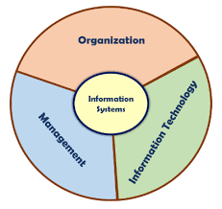
Perspectives of Information System
Using IS effectively, requires an understanding an organization, management, and information technology shaping the systems. An IS creates value for the firm as an organizational and management solution to challenges posed by the environment.

Slide 6
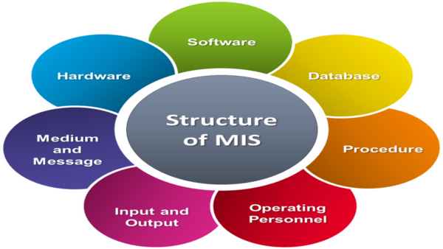
Management Information System
The MIS is defined as a system based on the database of the evolved for the purpose of providing information to the people in the organization.
MIS are distinct from regular IS in that MIS are used to analyze other information systems applied in operational activities in the organization.
MIS involve three primary resources: technology, information, and people.
MIS are regarded to be a subset of the overall internal controls procedures in a business, which cover the application of people, documents, technologies, and procedures used by management accountants to solve business problems such as costing a product, service or a business-wide strategy.

Slide 7
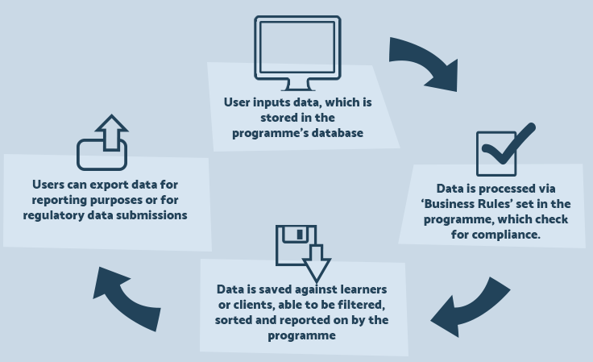
Typical use of MIS
In practice, Management Information Systems are used to store and control actual data to the day-to-day operation of a business. This can include financial data, statutory data, and many other forms of information tracked by an organization.

Slide 8
Role of MIS
The role of MIS in an organization can be compared to the role of the heart in the body. The information is the blood and MIS is the heart. In the body, the heart plays the role of supplying pure blood to all the elements of the body including the brain. The MIS plays the same role in the organization.
The system ensures that appropriate data is collected from various sources, processed, and sent further to all the needy destinations.
The system is expected to fulfill the information needs of an individual, a group of individuals, and the management functionaries: the managers and the top management.
The MIS helps in Strategic Planning, Management Control, Operational Control, and Transaction Processing.
The main aim of MIS is to inform management and help them make informed decisions about management and the way the business is run.

Slide 9
Types of MIS
Transaction processing systems. These systems process a large volume of routine, recurring transactions.
Operations information systems. These systems gather comprehensive data, organize it and summarize it in a form that is useful for managers.
Decision support systems. These systems help managers with the necessary information to make intelligent decisions.
Expert systems. They are meant to mimic humans in making decisions in a specific field.

Slide 10
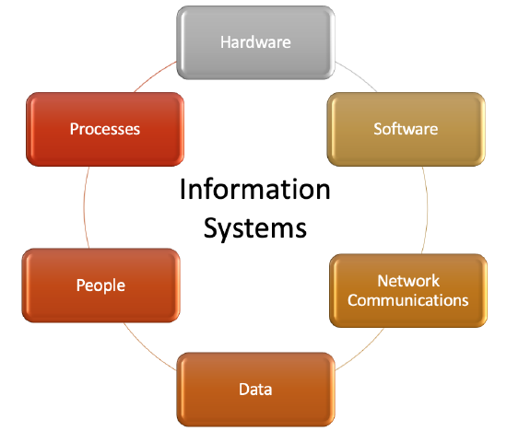
Components of MIS
MIS

Slide 11
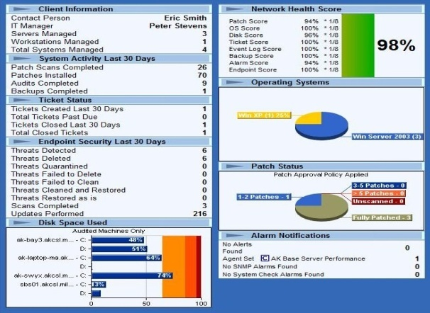
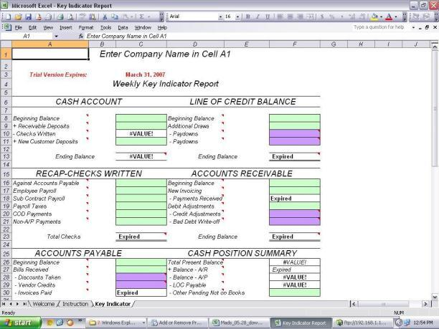
Outputs of MIS
Scheduled reports which are produced periodically, or on a Schedule (daily, weekly, monthly).
Key-indicator report which summarizes the previous day’s critical activities and also it is typically available at the beginning of each day.

Slide 12
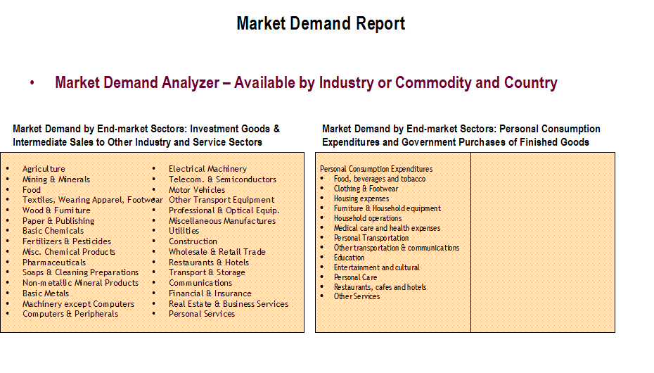
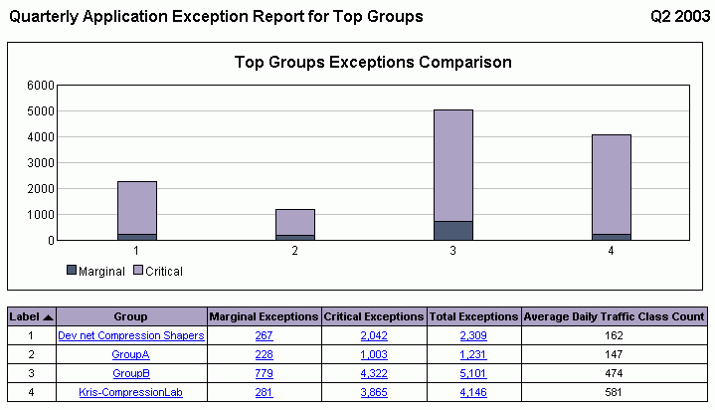
Outputs of MIS (cont.)
Demand report which gives certain information at a manager’s request.
Exception report which is automatically produced when a situation is unusual or requires management action.

Slide 13
Benefits of MIS
It improves personal efficiency.
It expedites problem-solving (speeds up the progress of problems solving in an organization).
It facilitates interpersonal communication.
It promotes learning or training.
It increases organizational control.
It generates new evidence in support of a decision.
It creates a competitive advantage over competition.
It encourages exploration and discovery on the part of the decision-maker.
It reveals new approaches to thinking about the problem space.
It helps automate the managerial processes.

Slide 14
Role of MIS in Business
To report on business operations with the purpose of supporting decision making.
This is to ensure that the organization is managed in a better and more efficient way so that it can be able to achieve full potential thus gain competitive advantage.
To provide information readily to company decision makers.
Regardless of whether it is a marketing, financial, or operational issue, managers need quick access to information so that they can make good decisions that will have a positive impact on the company’s performance. MIS enhances this by strategically storing vast amounts of information about the company in a central location that can be easily accessed by managers over a network. This means that managers from different departments have access to the same information hence they will be able to make decisions that collectively help solve the company’s problems most quickly.

Slide 15
How MIS contributes to decision making process (1)
Data Collection and Storage
Role: MIS collects data from various sources, both internal (e.g., sales, inventory, financial records) and external (e.g., market trends, customer feedback). It stores this data in a structured format, making it easily accessible for analysis.
Impact on Decision-Making: Managers can rely on accurate, up-to-date information to make decisions, rather than on guesswork or outdated data.
Data Processing and Analysis
Role: MIS processes the collected data to transform raw information into meaningful insights. This can include summarizing data, generating reports, and identifying trends.
Impact on Decision-Making: By providing analyzed data, MIS helps managers understand patterns, forecast future trends, and identify potential issues before they become critical, leading to more proactive decision-making.

Slide 16
How MIS contributes to decision making process (2)
Support for Strategic Planning
Role: MIS provides tools and reports that help in long-term strategic planning, such as financial projections, market analysis, and competitor analysis.
Impact on Decision-Making: Strategic decisions, such as entering new markets, launching products, or investing in technology, are supported by solid data and insights from MIS, reducing the risk of failure.
Operational Decision Support
Role: On a day-to-day basis, MIS supports operational decisions, such as inventory management, scheduling, and resource allocation. It offers real-time data that helps managers optimize operations.
Impact on Decision-Making: Managers can make quick, informed decisions that improve efficiency and productivity, ensuring smooth operations.

Slide 17
How MIS contributes to decision making process (3)
Problem Identification and Resolution
Role: MIS can help identify problems by highlighting deviations from expected performance, such as declining sales or increasing costs. It provides diagnostic tools to analyze the root causes.
Impact on Decision-Making: Early identification and understanding of problems enable managers to take corrective actions promptly, minimizing negative impacts on the organization.
Facilitating Communication and Collaboration
Role: MIS facilitates the flow of information within the organization, enabling better communication and collaboration among departments. It often includes tools for sharing reports, dashboards, and analytics.
Impact on Decision-Making: Improved communication ensures that all relevant stakeholders are informed and can contribute to decision-making processes, leading to more comprehensive and well-rounded decisions.

Slide 18
How MIS contributes to decision making process (4)
Risk Management
Role: MIS provides data and analytical tools that help in assessing risks, such as financial risks, market risks, or operational risks. It can simulate various scenarios and predict outcomes.
Impact on Decision-Making: Managers can make informed decisions that balance potential risks with rewards, leading to more resilient and sustainable strategies.
Performance Monitoring and Control
Role: MIS enables continuous monitoring of organizational performance against set goals and benchmarks. It generates reports that help managers track progress and make necessary adjustments.
Impact on Decision-Making: Continuous performance monitoring allows for timely decision-making, ensuring that the organization stays on track to achieve its objectives.

Slide 19
Role of MIS in Business (cont.)
To collect data.
Data from everyday operations in the company is collected and brought together with data from sources outside the organization. This enables a healthy and functional relationship between distributors, retail outlets and any other members of the supply chain. It also helps keep good track of performance since production and sales numbers will be recorded and stored in a central database that can be accessed by all members of the MIS. Access to this information also helps ensure that problems are detected early and decisions are made quickly using the latest information.
To promote collaboration in the workplace.
In any large company, many situations call for input from several individuals or departments before decisions can be made. Without an efficient communication channel, these decisions can take a very long time.
To run possible scenarios in different business environments.
Before making a decision that will affect the overall standing of the business, a lot of precautions must be taken. There is a need to check and verify that the company will not suffer after making a decision. Management Information Systems enable executives to run what-if scenarios so that they can see how some of the important metrics in the business will be affected by a given decision.

Slide 20
Advantage of MIS
All stakeholders in the company have access to one single database that holds all the data that will be needed in day-to-day operations.
Employees and other stakeholders in the organization will be able to spend more time doing productive tasks.
MIS brings the power of data processing tools that help significantly improve the quality of decisions made in the company.
MIS ensures that employees have easier and closer interaction with information about the progress of any process within the organization using mobile devices.
Management Information Systems help reduce the amount of paperwork.
Reports make it easy for companies to easily identify their strengths and weaknesses in carrying out various tasks.
From a top executive perspective, MIS helps give an overall impression of where the company stands financially.
MIS helps eliminate redundant roles.

Slide 21
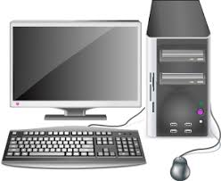
Computer Systems

Slide 22
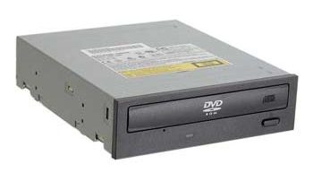
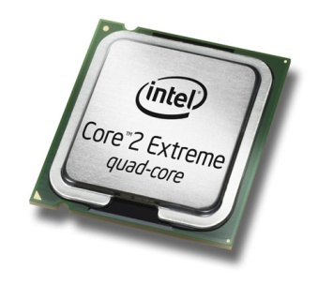
Hardware & Software
Hardware
All of the electronic and mechanical equipment in a computer is called the hardware. Examples include:
  Motherboard
  Hard disk
  RAM
  Power supply
  Processor
  Case
  Monitor
  Keyboard
  Mouse

Slide 23
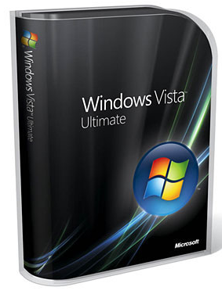


Hardware & Software
Software
The term software is used to describe computer programs that perform a task or tasks on a computer system. Software can be grouped as follows:
  System software - Operating System etc.
  Utility programs - Antivirus etc.
  Applications Software - Word, SolidWorks etc.

Slide 24
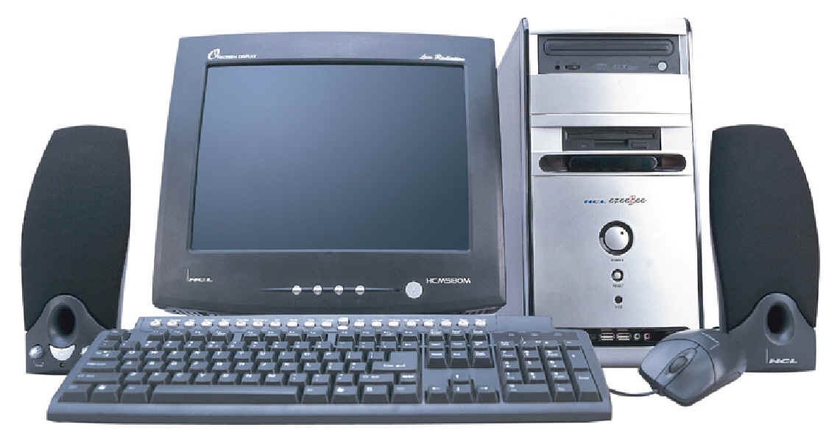
PC Components
Computer system - collection of electronic and mechanical devices operating as a unit. The main parts are:
  System unit
  Monitor
  Keyboard
  Mouse
  Speakers
2
1
5
3
4

Slide 25
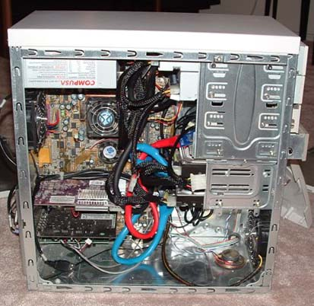
System Unit
The system unit is the main container for system devices. It protects the delicate electronic and mechanical devices from damage. Typical system unit devices include:
  Motherboard
  CPU (Processor)
  Memory
  Disk drives
  Ports - USB etc.
  Power supply
  Expansion cards (sound card, network card, graphics card etc.)

Slide 26
Peripherals
Peripherals are devices that connect to the system unit using cables or wireless technologies. Typical peripherals include:
  Monitor
  Keyboard
  Printer
  Plotter
  Scanner
  Speakers

Slide 27
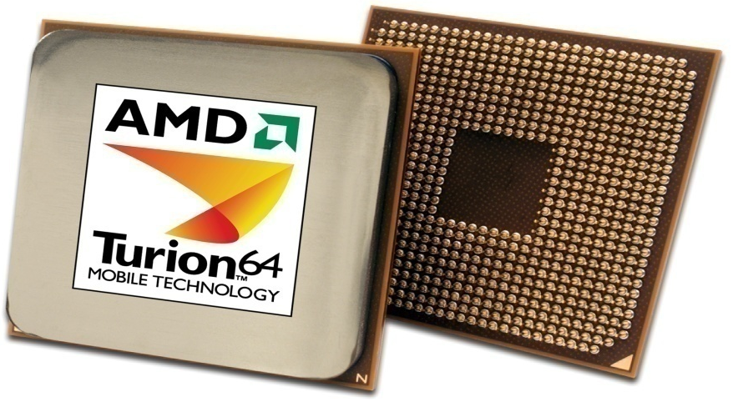
System Devices
Processor
An integrated circuit (IC) supplied on a single silicon chip. It’s role is to control all the computers functions. The most well-known and widely used computer processor unit’s (CPU) manufacturers are:
  AMD - Athlon and Turion (mobile)
  Intel - Pentium and Centrino (mobile)
AMD
Processor

Slide 28

System Devices
Computer program - a series of instructions. When a program is run, the processor carries out these instructions in an orderly fashion. Typical instructions include:
Arithmetic - addition, subtraction etc.
Logical - comparing data and acting according to the result.
Move - move data from place to place within the computer system - memory to the processor for addition - memory to a printer or disk drive etc.

Slide 29
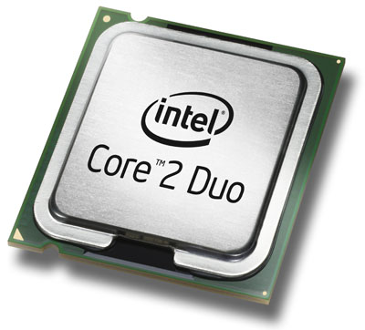
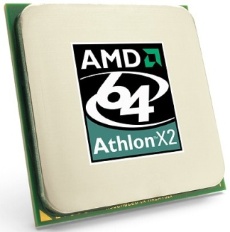
System Devices
Processor speed - measured in megahertz (MHz) or Gigahertz (GHz) - the speed of the system clock (clock speed) within the processor and it controls how fast instructions are executed:
1 MHz - 1 million clock ticks every second
1 GHz - 1 billion clock ticks every second
Multi-core processors can have two, three or four processor cores on a single chip.

Slide 30
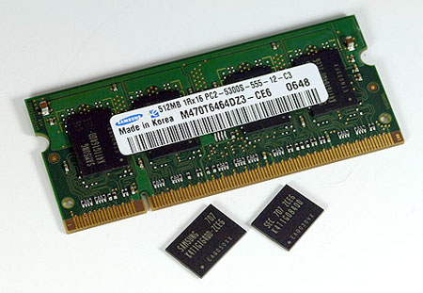
System Devices
Random Access Memory (RAM)
Primary storage - main computer memory. Data, programs currently in use are held in RAM;
Volatile - contents of memory are lost if the computer is turned off;
Module - memory integral circuit’s (IC) on a circuit board;
IC’s
Memory
Module

Slide 31
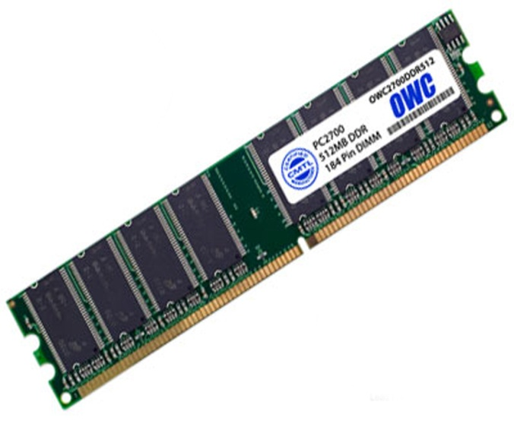
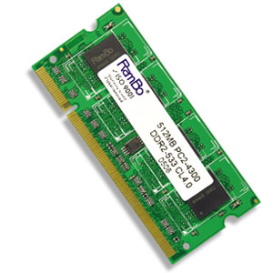
System Devices
Memory is sold in modules:
DIMM’s (dual inline memory module) for desktop computers.
SODIMM’s (small outline dual inline memory module) for notebook computers.
DIMM
Module
SODIMM
Module

Slide 32
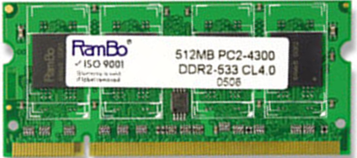
System Devices
DIMM’s and SODIMM’s are available in modules of 256MB, 512MB, 1GB, 2GB.
The current technology is called DDR (double data ram) and there are three types: DDR1, DDR2, DDR3.
Any particular computer system is only compatible with one type.
Module capacity
Module name
Module type
Module speed

Slide 33
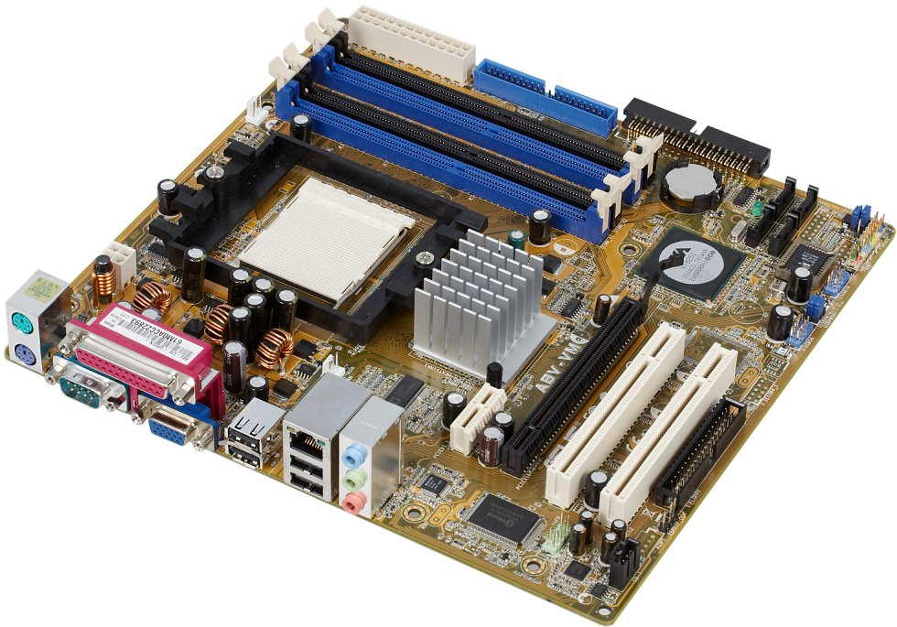
System Devices
Motherboard
Mainboard or system board - the main circuit board for the computer system.
All device in the computer system will either be part of the motherboard or connected to it.
Memory Sockets
Processor Socket
Chipset
PCI Slots
Ports
Graphics Slot

Slide 34
System Devices
Processor socket - different processors require different sockets and a motherboard must be chosen to suit the processor intended for use:
Socket 478 - Intel Pentium IV
Socket 775 - Intel Dual Core and Core Duo
Socket 754 - AMD Athlon
Socket 939 - AMD Athlon 64
Socket AM2 - AMD Athlon X2

Slide 35
System Devices
Chipset - controls data flow around the computer. It consists of two chips:
Northbridge - data flow between memory and processor - data flow between the processor and the graphic's card.
Southbridge - controls data flow to the devices - USB, IDE, SATA, LAN and Audio - controls PCI slots and onboard graphics.

Slide 36
System Devices
Buses - a path through which data can be sent to the different parts of the computer system. Main buses:
Processor
Front Side Bus
RAM
Northbridge
All Memory
Graphics Slot
PC-Express or AGP
Graphics Bus
Memory Bus
Internal Bus
Southbridge
IDE
SATA
USB
LAN
Audio
Onboard
Graphics
PCI Slots
PCI Bus
PCI Bus

Slide 37
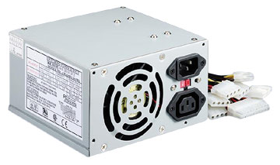
System Devices
Power Supply
A computer power supply has a number of functions:
Converts Alternating current (AC) Direct current (DC)
Transforms mains voltage (240 Volts) to the voltages required by the computer. The main voltages are:
  12 volts for the disk drives as they have motors
  3.3 and 5 volts for the circuit boards in the computer

Slide 38
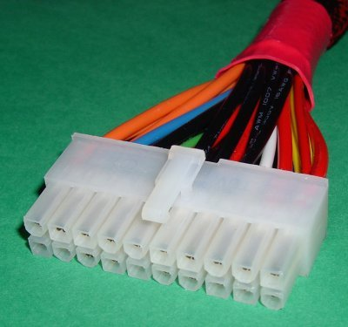
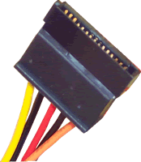
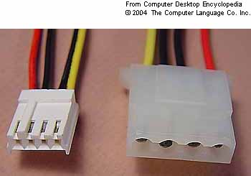
System Devices
Uses advances power management (APM) to allow the computer go into a standby mode.
Some have a switch to toggle between 240 volt supplies and 110 volt supplies.
The main connections are:
3
4
1
2
1 | Main connector | Connects to the motherboard and supplies the 3.3 and 5 volt supply for the board.
2 | Molex connector | Connects IDE hard drives and optical drives.
3 | Berg connector | Connects floppy disk drives.
4 | SATA connector | Connects SATA drives.

Slide 39
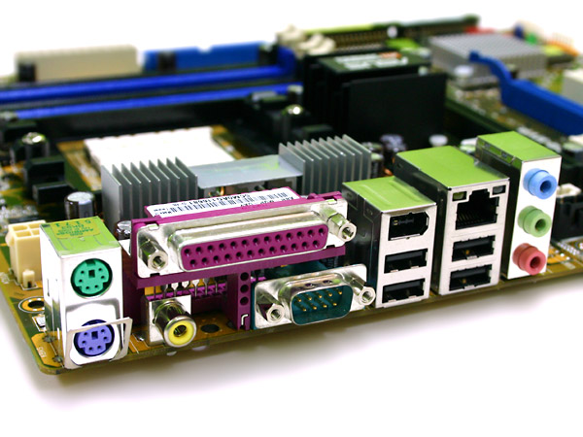
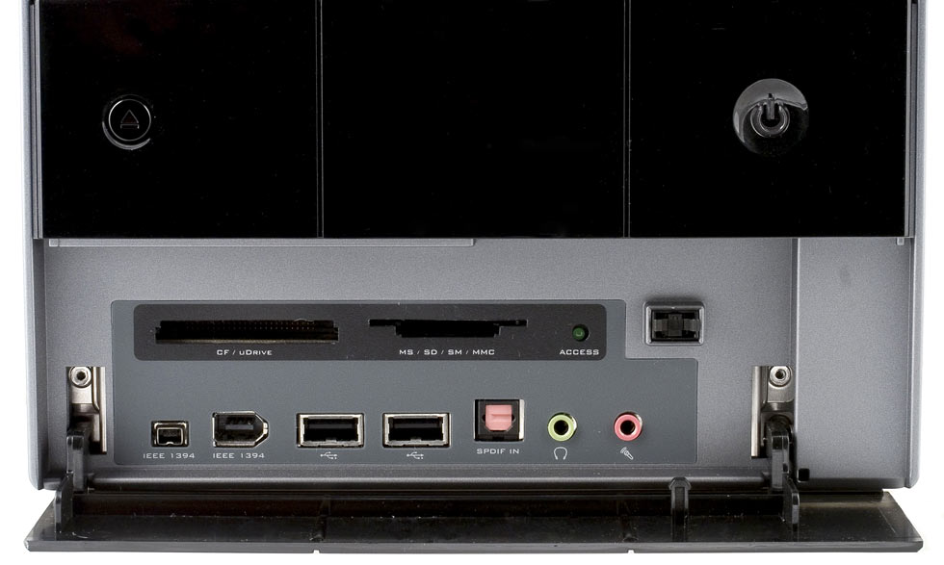
System Devices
Ports
Computer ports are interfaces between peripheral devices and the computer. They are mainly found at the back of the computer but are often also built into the front of the computer chassis for easy access.
Ports at the rear of the computer
Ports at the front of the computer

Slide 40
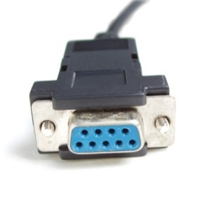
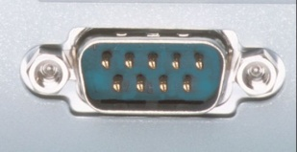
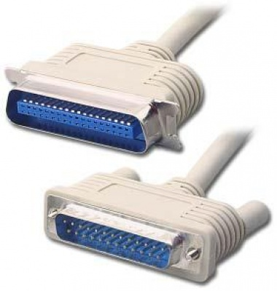
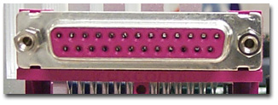
System Devices
Serial port - a 9-pin port. Often called Com ports - Com1, Com2 etc. Mice and external modems were connected to these ports. They are turquoise in colour.
Parallel port - a 25-pin port used to connect printers, scanners, external hard disks, zip drives etc. to the computer. Burgundy in colour, they are often called LPT ports - LPT1, LPT2 etc.

Slide 41
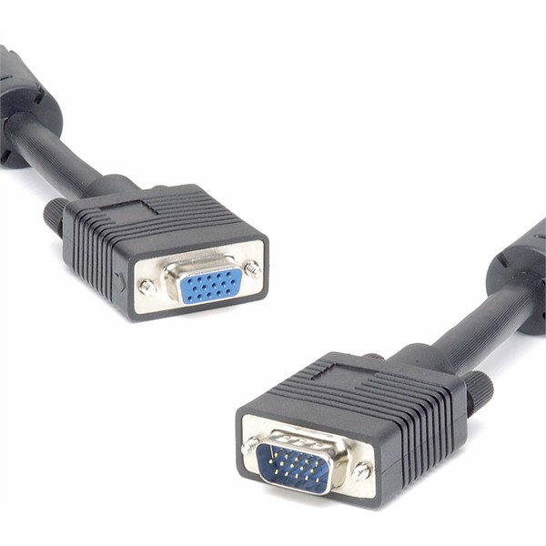
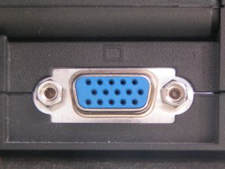
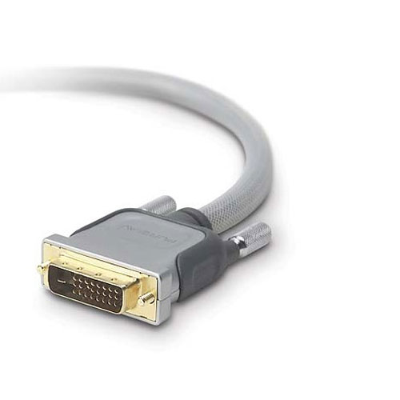
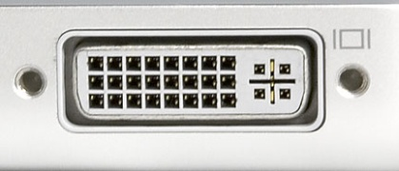
System Devices
Video port - used to connect a monitor to the computer system. There are two types:
VGA port - This is a 15-pin port and is blue in colour. It is an analogue port and is being replaced by the DVI port.
DVI port - white in colour, it is a digital port. This means that no conversion is necessary between the computer and the monitor and that means that images can be produced more quickly on the monitor

Slide 42
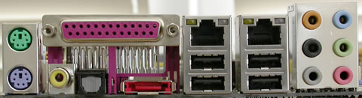
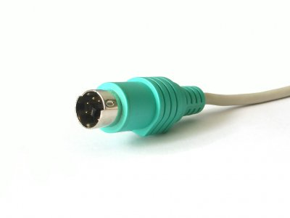
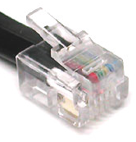
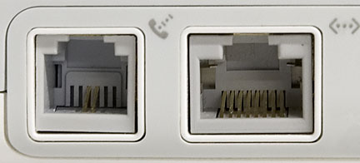
System Devices
PS/2 port - used to connect keyboards and mice to the computer. The keyboard port is purple and the mouse port is green.
Modem port - used to connect a modem to a telephone line. RJ11 is the technical term for the port.

Slide 43
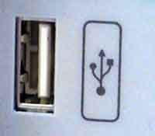
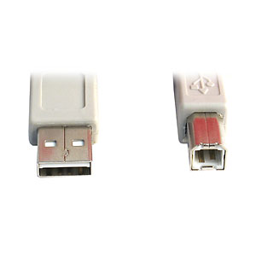
System Devices
USB port - intended to replace Serial, Parallel and PS/2 ports with a single standard. 127 devices can be connected to a single USB port.
Hot swappable - devices can be connected and disconnected while the computer is on.

Slide 44
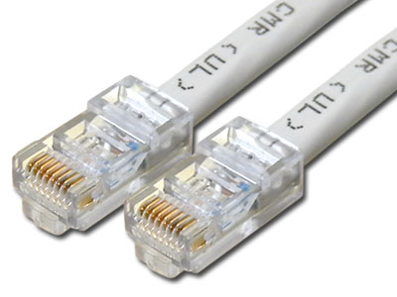
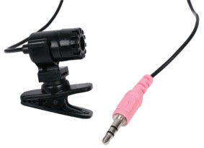
System Devices
Ethernet port - used to connect to a network. Known as RJ45, it is larger than a modem port.
Audio ports - used to input and output audio from the computer. Three mini jack ports but there may be more:
  Light blue - Line in - connect external devices
  Lime - Connect the speakers to this port.
  Pink - Connect a microphone to this port.

Slide 45
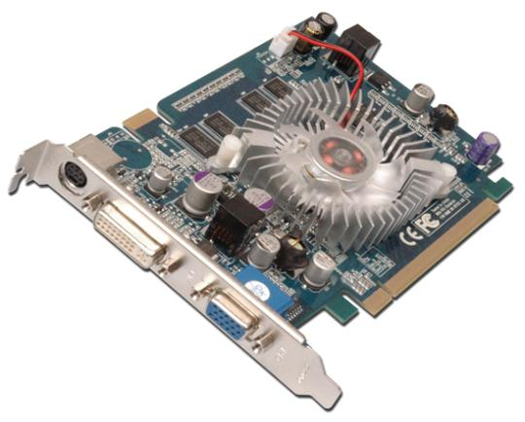
System Devices
Motherboard layout
3
1
4
2
5
1 | Processor and fan | Graphics card handles it’s own processing making it almost independent of the processor.
2 | Board connector | AGP or PCI-Express
3 | Memory | Graphics card has it’s own memory. This makes it much faster. Most new cards use DDR3 memory.
4 | DVI connector | Digital output is supplied through this port.
5 | VGA connector | Analogue output is provided through this port.

Slide 46
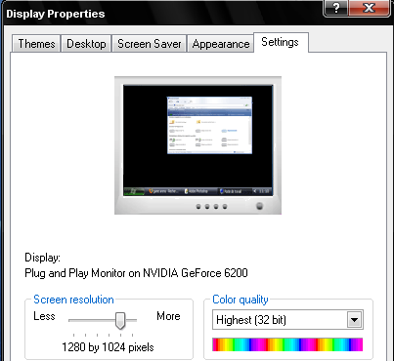
System Devices
Graphics card
Graphic card - screen images are made up of dots called pixels (picture elements). The graphics card must process each of these pixels to create the image.
The resolution of a screen is the number of pixels being displayed. Typical resolutions include:
800 x 600 480,000 pixels
1024 x 768 786,432 pixels
1280 x 1024 1,310,720 pixels
1600 x 1200 1,920,000 pixels
………

Slide 47
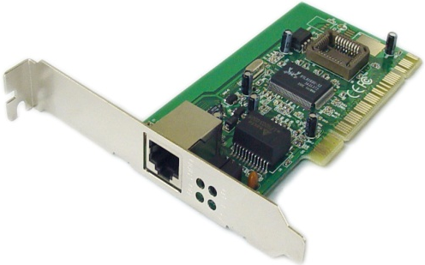
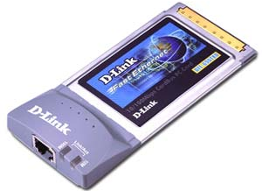
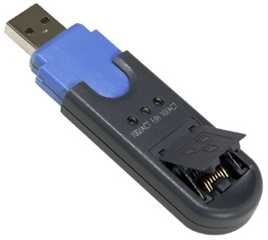
System Devices
Network card
Allows computers join a network. Can be wired or wireless. The standard used is called Ethernet - covers wired and wireless networks.
The wired standards include:
Fast Ethernet - transmission speed of 100 Mbps.
Gigabyte Ethernet - transmission speed of 1000 Mbps.
PCI
PC card
USB

Slide 48
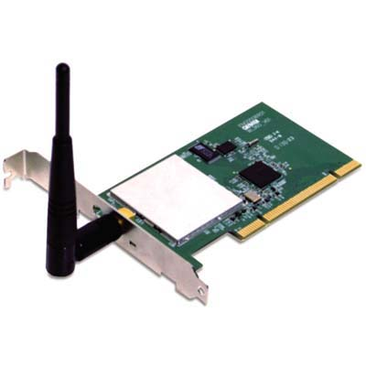


System Devices
The wireless standards include:
The B standard - introduced in 1999, it has a transmission rate of 11 Mbps and a range of 30 Metres.
The G standard - introduced in 2003, it has a transmission rate of 54 Mbps and a range of 30 Metres.
The N standard - introduced in 2006, it has a transmission speed of 540 Mbps and a range of 50 metres.
PCI
PC Card
USB

Slide 49


System Devices
  Modem
  Internet access using a telephone line.
  Converts the digital to analogue computer data (Modulation), before transmission over the telephone line and converts the analogue data to digital (DEModulation) before transmission to the computer. The device gets it’s name from these two terms.
PCI
USB

Slide 50
System Devices
Hard Disk
Primary storage (memory) - volatile - contents lost when power is turned off.
Secondary storage (disk drives) - non-volatile - can store files when power is turned off.

Slide 51

System Devices
Disk drive
A metal disk (platter) is coated with tiny iron particles which can be magnetised to north and south to represent the binary digits 0 and 1.
A read-write head is used to magnetise the particles on the disk surface to represent the data held in RAM. The computer can now be switched off and a copy of the data is safe for later use.
Metal disk
(platter)
covered with iron particles.
Read-write
head

Slide 52


System Devices
Hard disks can be internal or external.
Integrated Drive Electronics (IDE)
The disks connect to the motherboard using a ribbon cable. Each cable can hold two drives - master and slave. The drive is set as master or slave by positioning a jumper switch on the back of the drive. There are two IDE connectors and a total of four drives can be connected.
Master
Slave
M/board
Jumper

Slide 53



System Devices
Serial Advanced Technology Attachment (SATA)
SATA allow faster data transfer speeds than Integrated Drive Electronics. There is no master/slave arrangement with SATA and each drive has it’s own cable. The cables are much smaller and allow better air circulation in the system unit.
SATA
Cable
Motherboard – Hard disks connectors
IDE
SATA

Slide 54

System Devices
Optical drive
Optical drives use lasers to sense pits and lands mechanically pressed into a polycarbonate disk. These pits and lands represent the binary 0’s and 1’s and so can store computer data.
A thin layer of metal reflect the laser light. As the disk rotates, the laser senses the pits and lands and reads the data from the disk. The laser only operates at a single intensity as it only scans the surface of the disk to detect the pits and lands.
Land
Pit

Slide 55

Peripherals
Monitor
A computer monitor displays images generated by the graphics card.
Monitors are almost exclusively LCD (Liquid Crystal Display).
CRT (Cathode Ray Tube) monitors are rare and are now as expensive as LCD monitors.
19 inch Widescreen LCD

Slide 56

Peripherals
Most LCD monitors offer a VGA and a DVI connection. The VGA connector is used for analogue signals and the DVI connector is used for digital. As the computer is a digital machine, it is best if no conversion is required and so the best option is the DVI connection.
DVI
VGA

Slide 57
Peripherals
Resolution
Standard monitor
  XGA (Extended Graphics Array) - 1024 x 768
  SXGA (Super Extended Graphics Array) - 1280 x 1024
  UXGA (Ultra Extended Graphics Array) - 1600 x 1200
  QXGA (Quad Extended Graphics Array) - 2048 x 1536
Widescreen
  WXGA (Wide XGA) - 1280 x 800
  WSXGA (Wide SXGA) - 1680 x 1050
  WUXGA (Wide UXGA) - 1920 x 1200
LCD monitors - native resolution at which the image is crisp. Other resolutions are possible but the image quality decreases.

Slide 58
Peripherals
Keyboard
Primary input device - divided into sections:
  Typing keys - contains the letter and number keys, shift keys, spacebar, return key etc.
  Numeric keypad - These keys are arranged as on a calculator.
  Function keys - programmable keys used by software for special functions. (ex: F1 - Help).
  Control keys - screen and cursor control.

Slide 59

Peripherals
  Most common arrangement is called QWERTY after the first six keys.
  Other arrangements are available including Dvorak, ABCDEF, AZERTY etc.
QWERTY
DVORAK

Slide 60


Peripherals
Keyboards are available wired or wireless:
  Wired - These are either PS/2 or USB.
  Wireless - The keyboard uses batteries.
Rubber keyboard - useful for use with notebook computers. Leaves users less prone to RSI (Repetitive Strain Injury)
Wireless keyboard

Slide 61


Peripherals
Mouse
Input device - uses point and click technology.
There are two main types:
Ball mouse - uses a ball to roll across the surface and move rollers attached to sensors inside the mouse - reflecting the ball movement as cursor movement.
Optical mouse - camera takes thousands of images per second and sends them for digital processing. The red LED lights up the surface for the camera.
Optical
mouse
Ball mouse

Slide 62


Peripherals
Printer
Output device - produce a hardcopy (permanent and readable) of computer data. The can print onto paper, transparency, photographic paper, card etc.
There are two main technologies involved:
  Inkjet (Bubble-jet)
  Laser
  Inkjet (Bubble-jet)
Laser

Slide 63


Peripherals
  Inkjet - uses an electric charge to vibrate a membrane. When the membrane flexes downwards, it ejects an ink droplet through the nozzle (1). When it flexes upwards, it draws more ink into the reservoir (2).
  Bubblejet - a heating element locally heats ink to form a bubble (1). As the bubble expands, it forces ink through the nozzle (2). When it bursts, it causes a vacuum which draws ink into the reservoir (3).
1
2
1
2
3

Slide 64

Peripherals
Laser printers use toner (powdered ink) instead of liquid ink as in inkjet printers.
Laser printers produce images using dots. The image is created using a laser beam and a mirror -lens arrangement on a drum coated with magnetically charged toner and then transferred from the drum to the paper. The paper is then fed through a heated fuser which fuses the toner to the paper as ink.
Laser
Toner
Fuser
Mirror and lens
Drum

Slide 65

Peripherals
Printers are available as A4, A3 and even A2, but if larger drawings and images are required, a plotter is more suitable.
Plotters use inkjet technology and are available in A3, A2, A1 and A0. They take up much less space than an equivalent inkjet or laser, bur are more expensive.
Plotter

Slide 66
Computer Specification
  Intel Core Duo Processor - 2.66MHz 64-Bit CPU, 128 KB L1 cache, 4MB L2 Cache, 1333MHz FSB
  Windows Vista Business
  4GB DDR2 Memory - 667MHz
  500GB SATA HDD 10,000rpm
  256MB DDR2 NVIDIA PCI-Express Graphics
  19" Widescreen LCD - 0.22mm Dot Pitch, Res -1490 x 900
  7:1 Surround Sound Inc. Woofer
  PCI-E Mainboard - nForce SLI, Micro ATX
  6 x USB2 Ports - 2 Front
  2 x 1394 Ports - 1 Front
  Broadcom GB LAN Network Connection
  Multi Card Reader
  18X SATA Dual Format Dual Layer DVDRW Drive
  550W Power Supply
  Logitech Wireless Internet Keyboard and Wireless Optical Mouse

Slide 67

Quick “In class Mock test”
An ...................... is a set of processes and procedures that transform data into information and knowledge.
  Information system
  Knowledge system
  Database system
  Computer system – Information Technology

Slide 68
Quick “In class Mock test”
Processing involves transforming input into .............
  Feedback
  Output
  Evaluation
  Profit

Slide 69
Quick “In class Mock test”
Which computer component is a device that presents and/or transmits data from the computer to the user?
  CPU
  RAM
  Output device
  Input device

Slide 70
Quick “In class Mock test”
A wireless technology built in electronic gadgets used for exchanging data over short distances is ..........
  USB
  Bluetooth
  Modem
  Wifi

Slide 71
Quick “In class Mock test”
Data becomes ……………. when it is presented in a format that people can understand and use.
  processed
  graphs
  information
  presentation

Slide 72
Quick “In class Mock test”
.............. design and write software.
  Systems developers
  Database administrators
  Systems analysts
  IT Consultants

Slide 73
Useful links
https://www.youtube.com/watch?v=q6WlzHLxNKI
Inside Amazon's Massive Data Center
https://www.youtube.com/watch?v=0_veMXUsutU
Why does Microsoft have underwater data centers?

Slide 74
Thank you for your attention!

